Slide 1

The Maryland SPARC Collaborative presents:
Throwing (Pre)Caution(s) to the Wind: SPARCing a Debate on Stopping Contact Precautions
May 2, 2019
12-1pm EST
Dial-in: 888-672-1467

Slide 2

Contact precautions:
What does the data really show?
Anthony Harris, MD, MPH
MD, MPH
Professor
Hospital Epidemiologist
University of Maryland

Slide 3
Cut to the chase

Slide 4
Arguments in favor of contact precautions
Antibiotic resistant bacteria transmission occurs in the hospital and infection control should aim to decrease this transmission
Healthcare worker clothing is frequently contaminated with antibiotic-resistant bacteria
Gloves and gowns become frequently contaminated when caring for patients
Contact precautions do not lead to an increase in adverse events
  BUGG randomized study
Contact precautions do not lead to an increase in anxiety and depression
Hand hygiene compliance will never be greater than 70%
Notes:
Bullet 2 ¹Treakle AM et al. AJIC 2009:101 ²Bearman GM et al. ICHE 2012:268
Bullet 3: Snyder et al ICHE 2008; Morgan et al ICHE 2010/CCM 2012; Rock et al ICHE 2014 and Hayden MK et al., ICHE 2008:149
Bullet 4: Harris et al., JAMA. 2013 Oct;310:1571
Bullet 5: Day et al., Infection Control and Hospital Epidemiology 2013
People who argue for the removal of contact precautions argue that you just have to improve hand hygiene compliance and you won’t need contact precautions.
Mention that I have references for these if needed.

Slide 5
Arguments against contact precautions
Cost
Environmental burden
Annoyance

Slide 6
DETAILS

Slide 7
Disclosures
UpToDate editor
Funding for BUGG Study Agency for Healthcare Research and Quality (AHRQ) under contract number HHSA290200600015i Task Order No. 5

Slide 8
Arguments to be made
Outline benefits of contact precautions
Demonstrate that contact precautions do not lead to negative events other than cost and annoyance
Thus, at this point in time, contact precautions should be used
Notes:
Outline that for second bullet we will be dealing with issues related to anxiety, depression, frequency of visits, and most importantly the issue related to adverse events.

Slide 9
How much of transmission is patient-to-patient?
Studies have estimated that up to 37% of nosocomial infections in ICUs are directly attributable to transmission of resistant organisms across patients
One of our common missions are healthcare providers should be to try to prevent this transmission
Notes:
Even if these numbers are an over-estimate the amount of pt to pt transmission cannot be denied.

Slide 10
C. diff and patient to patient transmission
Kong et al (CID 2019: 68 p 204) was able to link 52% of CDI cases to a carrier and/or patient with CDI
Zacharioudakis (Am J Gastro 2015) showed that 2/3 of HO CDI cases were not colonized on admission, so clearly represent a new acquisition
Curry (CID 2013) was able to link 30% of new CDI cases to other patients

Slide 11
Benefits: healthcare worker hands are contaminated prior to room entry
Contact precautions (use of gloves) prevent this potential transmission to patients
One study showed 11% Staph aureus, 6% Acinetobacter, 2% Enterococcus¹
Our group showed MRSA 2%, Acinetobacter 2%²
Notes:
-our esteemed leader of this spring symposium munoz-price

Slide 12

Clothing is frequently contaminated
Lab coats are frequently contaminated¹
  Among 149 grand rounds attendees, 23% were contaminated with S aureus, of which 18% were MRSA
Scrubs are frequently contaminated²
  MRSA contamination of 50%
  Gram-negative contamination of 13%
Notes:
-Note that the second reference is from Mike Edmond’s/gonzalo bearman group. In fact, Mike has done studies trying to design a better scrub which I agree with but until we get that better scrub, we need contact precautions.

Slide 13

Gloves and gowns are protective
Among 103 HCWs whose hand samples were negative for VRE when they entered the room, 50-70% contaminated their hands or gloves
Notes:
after touching the environment
70% contaminated their hands or gloves after touching the patient and the environment

Slide 14
Gloves and gowns are protective
Organism | Glove or Gown Contamination rate post patient contact | Gown Contamination post patient contact
VRE | 11% | 5%
MRSA | 16% | 5%
KPC | 14% | 3%
MDR P. aeruginosa | 14% | 3%
MDR A. baumannii | 33% | 13%
Notes:
This is done during routine visits to patients on contact precautions. What it shows is the high rate of contamination in the icu setting? If you are not wearing contact precautions you are frequently contaminating your hands and clothing. Large NIH R01 study across multiple hospitals in the US shows these same rates for MRSA and CRE

Slide 15
Contact precautions improve hand hygiene
Glove use increased hand hygiene compliance almost four fold¹
Thompson LTCF study: glove use improved hand hygiene before (RR, 1.76) and after (RR, 2.68)²
¹Kim PW et al., AJIC 2003:97
²Thompson BL et al., ICHE 1997:97

Slide 16
Randomized trial: Improved hand hygiene on room exit with gown and gloving
¹Harris et al., JAMA. 2013 Oct;310:1571

Slide 17
Experts like the CDC still strongly recommend it
CDC in their MDRO guidelines recommend Contact Precautions
  “Successful control of MDROs has been documented in the United States and abroad using a variety of combined interventions. These include improvements in hand hygiene, use of Contact Precautions until patients are culture-negative for a target MDRO, active surveillance cultures (ASC), education, enhanced environmental cleaning, and improvements in communication about patients with MDROs within and between healthcare facilities.”
CDC re-emphasized this in MMWR Vital Signs (2018 and 2019)
Notes:
Make the point that experts recommend it because it is useful.

Slide 18
Potential cons of contact precautions

Slide 19
Potential cons of contact precautions that people raise: Some are true/Some as you will see are not
Decreased frequency of healthcare worker visits
Adverse events
Anxiety
Depression
Notes:
My fellow speaker is going to try to convince you that contact precautions lead to all of these adverse events.

Slide 20
Contact Precautions do lead to less healthcare worker visits
 | Design | Effect
Kirkland & Weinstein 1999 | Cohort | 2.1 vs. 4.2 hourly contacts with HCWs
Saint et al 2003 | Cohort | 35% vs. 73% patients examined by attending physicians
Evans et al 2003 | Matched cohort | 5.3 vs. 10.9 contacts HCWs 22% less contact time overall
Morgan et al 2013 | Cohort | 2.78 vs. 4.37 visits/hour 17.7% less contact time 23.6% fewer visitors
Harris et al 2013 | Randomized controlled trial | 4.28 vs. 5.24 visits/hour
Notes:
mention that they are going in more efficiently. They are bundling interventions.

Slide 21
Some suggest less frequent visits is a good thing
Syndrome of Trauma Hospitalization
Effective interventions
  Reduce disruptions
  Increase sleep
Detsky A, Krumholtz HZ, JAMA. 2014 Jun;311:2169
Notes:
In this article in JAMA, Detsky and Krumholtz describe the the syndrome of trauma hospitalization that is similar to post-traumatic stress disorder. They suggest a multi-faceted intervention of which one component involves less disruptions:

Slide 22
Major paper that suggested increase in adverse events: Stelfox et al.
General Cohort
Congestive Heart
Failure Cohort
Precautions n=78
Controls n=156
Precautions n=72
Controls n=144
Outcomes:
Length of Stay* 31 vs. 12 days 8 vs. 6 days
any Adverse Event* 17% vs. 7% 47% vs. 25%
Preventable AE* 12% vs. 3% 29% vs. 4%
Death 27% vs. 18% 21% vs. 15%
Notes:
This slide gets at the study that led to the momentum suggesting that contact precautions led to an increase in adverse events.

Slide 23
Major paper that suggested increase in adverse events: Stelfox et al.
General Cohort
Congestive Heart
Failure Cohort
Precautions n=78
Controls n=156
Precautions n=72
Controls n=144
Difference in Adverse Events due to:
—falls
— pressure ulcers
— fluid & electrolyte disorders
Outcomes:
Length of Stay* 31 vs. 12 days 8 vs. 6 days
any Adverse Event* 17% vs. 7% 47% vs. 25%
Preventable AE* 12% vs. 3% 29% vs. 4%
Death 27% vs. 18% 21% vs. 15%
Rate Ratio (RR) any AE 2.2
Rate Ratio (RR) preventable AE 7.0

Slide 24
Major paper that suggested increase in adverse events: Stelfox et al.
General Cohort
Congestive Heart
Failure Cohort
Precautions n=78
Controls n=156
Precautions n=72
Controls n=144
However, study never adequately controlled for severity of illness
Outcomes:
Length of Stay* 31 vs. 12 days 8 vs. 6 days
any Adverse Event* 17% vs. 7% 47% vs. 25%
Preventable AE* 12% vs. 3% 29% vs. 4%
Death 27% vs. 18% 21% vs. 15%
Rate Ratio (RR) any AE 2.2
Rate Ratio (RR) preventable AE 7.0
Notes:
-

Slide 25
BUGG Study
Agency for Healthcare Research and Quality (AHRQ) under contract number HHSA290200600015i Task Order No. 5
¹Harris et al., JAMA. 2013 Oct;310:1571

Slide 26
BUGG study overview
20 ICUs enrolled in study
20 ICUs completed baseline data collection
6324 admissions
20646 swabs
10 ICUs allocated to intervention group
10 ICUs allocated to control group
0 ICUs lost to follow-up
0 ICUs lost to follow-up
10 ICUs included in primary analysis
9936 admissions
36007 swabs
10 ICUs included in primary analysis
9920 admissions
35588 swabs
¹Harris et al., JAMA. 2013 Oct;310:1571

Slide 27
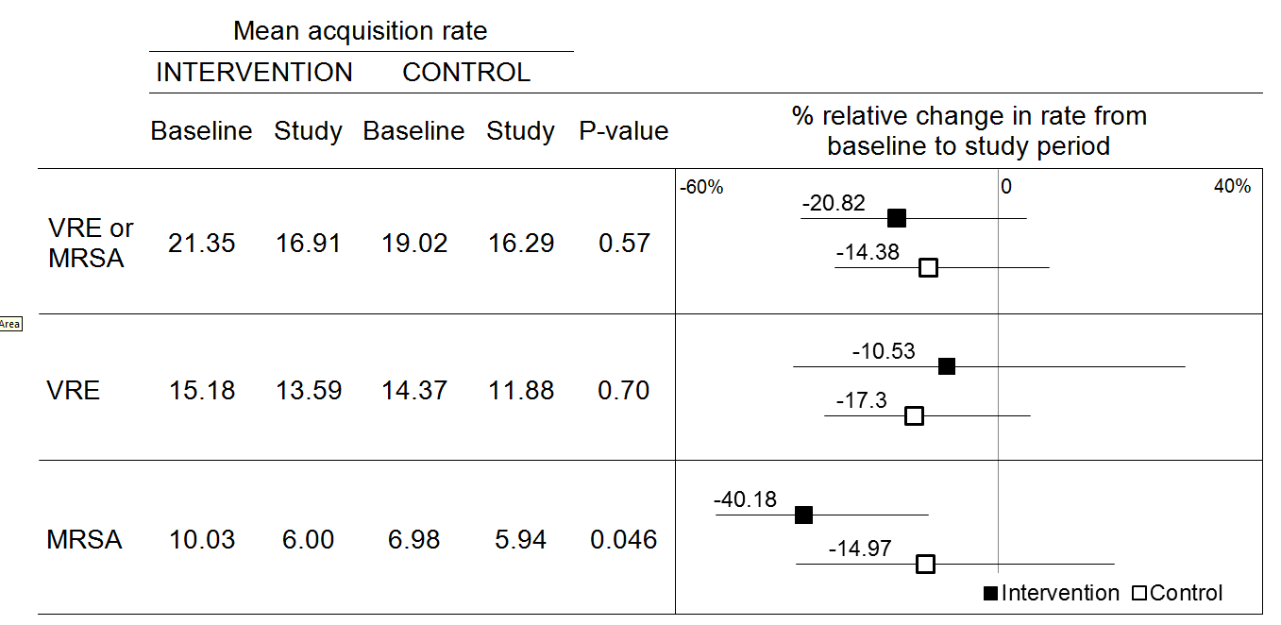
BUGG study: decreased MRSA, no effect on VRE

Slide 28
Effect of universal glove and gown even at sites that use chlorhexidine bathing
(1) Morgan D et. al Infect Control Hosp Epidemiol. 2015 Jun;36:734
Notes:
Around the time that this study was published, people became aware of the robustness of CHG bathing. So we decided to address whether the effect of universal glove and gown was present even among sites that performed CHG bathing.

Slide 29
BUGG study: decreased HCW visits with gown and gloving

Slide 30
BUGG study: trend towards decreased adverse events
ICU adverse events lower in the intervention arm but this difference is not statistically significant (p=.24)
  58.7 events per 1000 patient days universal glove and gown
  74.4 events per 1000 patient days control

Slide 31
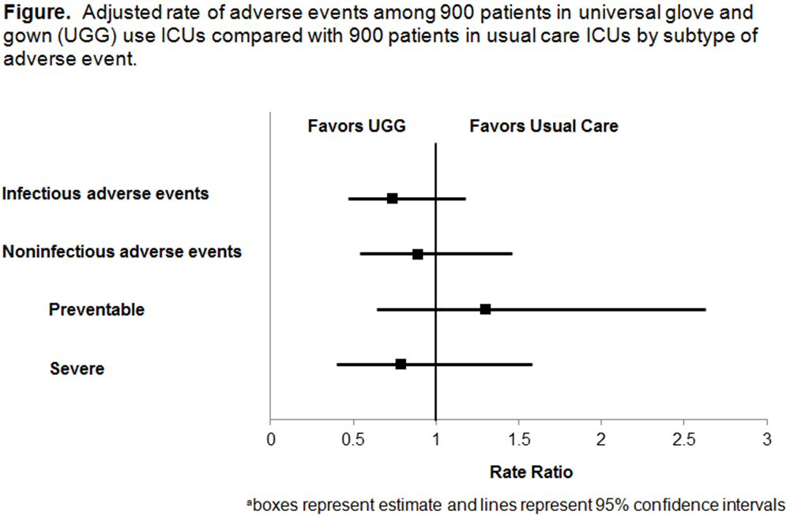

Slide 32
Early cross-sectional studies suggested increased depression and anxiety
 | Setting | Design | Effect
Kennedy & Hamilton 1997 | Spinal Cord rehab unit | 16 cases/ 16 controls | 85% believed CP limited rehab, More Anger 12.3 vs. 16.5 depression scores (NS)
Gammon 1998 | Wards, 3 hospitals | 20 cases/ 20 controls | 30% higher depression and anxiety scores
Tarzi et al 2001 | Rehab unit | 20 cases/ 20 controls | 33% vs. 77% depression 8.6 vs. 15 anxiety scores
Wassenberg et al. 2010 | Tertiary Hospital | 42 cases/ 84 controls | Small, nonsignificant difference in depression/anxiety at admission
Day et al. 2011 | Veterans Hospital | 20 cases/ 83 controls | Small, nonsignificant difference in depression/anxiety at admission
Day et al. 2011 | Tertiary Hospital | Cohort of 28,564 | 40% more diagnoses of depression No difference in diagnosis of anxiety

Slide 33
Cross-Sectional Studies of Psychological Effects
 | Setting | Design | Effect
Kennedy & Hamilton 1997 | Spinal Cord rehab unit | 16 cases/ 16 controls | 85% believed CP limited rehab, More Anger 12.3 vs. 16.5 depression scores (NS)
Gammon 1998 | Wards, 3 hospitals | 20 cases/ 20 controls | 30% higher depression and anxiety scores
Tarzi et al 2001 | Rehab unit | 20 cases/ 20 controls | 33% vs. 77% depression 8.6 vs. 15 anxiety scores
Wassenberg et al. 2010 | Tertiary Hospital | 42 cases/ 84 controls | Small, nonsignificant difference in depression/anxiety at admission
Day et al. 2011 | Veterans Hospital | 20 cases/ 83 controls | Small, nonsignificant difference in depression/anxiety at admission
Day et al. 2011 | Tertiary Hospital | Cohort of 28,564 | 40% more diagnoses of depression No difference in diagnosis of anxiety
All are studies of prevalence….do not show causality
(Contact Precautions = sicker patients)

Slide 34
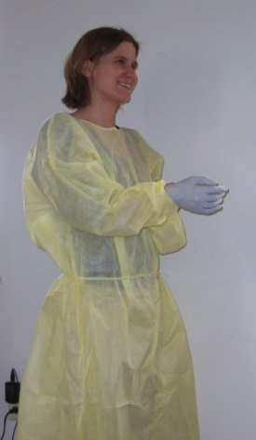
Depression, Anxiety and Emotional States in Contact Precautions: Cohort study
Prospective Cohort Study
Patients exposed to contact precautions matched to unexposed by hospital ward and month
148 cases vs. 148 controls
Hospital Anxiety and Depression Scale
(HADS)
Day et al., Infection Control and Hospital Epidemiology 2013

Slide 35
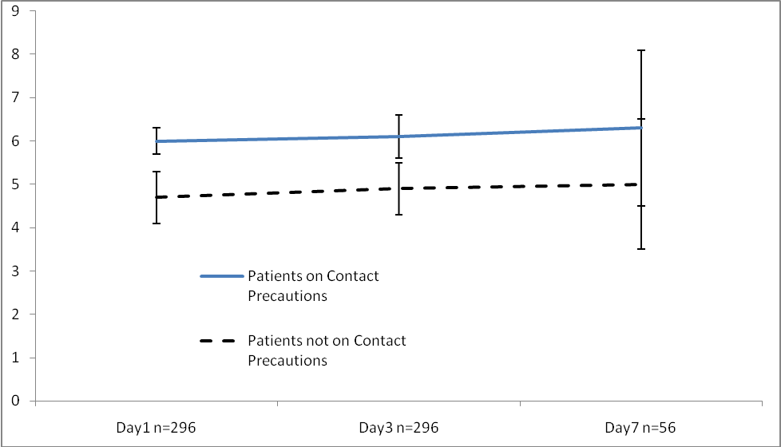
Depressive Symptoms Stable with CP
6.0
6.1
6.3
HADS-D
5.0
4.0
4.9

Slide 36
Anxiety symptoms stable with CP
7.5
7.2
7.5
6.7
6.1
5.6
HADS-A
Notes:
Don’t focus on decrease over time

Slide 37
Summary of No Psychological effects of Contact Precautions
Patients on Contact Precautions tend to have more depression and anxiety on admission likely due to their comorbid conditions
Exposure to Contact Precautions does not appear to cause more depression, anxiety or emotional changes

Slide 38
CONTACT PRECAUTIONS AND LACK OF ADVERSE EVENTS AMONG FLOOR PATIENTS
Prospective cohort
296 general ward patients
Enrolled January 1, 2010 to November 17, 2010
148 Contact Precautions patients matched to 148 non-Contact Precautions patients
  Enrollment location
  Initial 3-day length of stay
Notes:
Original cohort for: association between CP & depression and anxiety (Hannah)
Individually matched (enrollment location categories: general medicine, surgery/transplant, oncology)

Slide 39
But what about the hospitals that have safely removed contact precautions?

Slide 40
Removing contact precautions: Uslan et al
Best of a weak group of remove contact precaution paper
Outcome: MRSA, VRE and C diff clinical culture rates as per LabId
Intervention: Removal of contact precautions and addition of CHG bathing
2 hospital study
Limitations: a) confounding of CHG b) no power calculations c) different baseline period for two hospitals d) no control for colonization pressure e) only six months of pre intervention data
Uslan D. Infect Control Hosp Epidemiol. 2016 Nov;37:1323.

Slide 41
Removing contact precautions: Edmond et al
Concise communication so maybe there is more data but little presented
Outcome: HAI
Limitations: a) no power calculations b) no numerator and denominator data c) no confidence intervals around hai rates
Edmond M. Infect Control Hosp Epidemiol. 2015 Aug;36:978.

Slide 42
But why can’t the definitive cluster trial of contact precautions be done?
Notes:
This then leads to a question that the epi centers have been debating for the last month or so. Our group has been trying to work on methodological issues of cluster trials in infection control.

Slide 43
We are not spending enough money on infection control interventions

Slide 44
Examples of much less cost effective interventions widely accepted
Robots for surgical procedures
  No data to support improved patient outcomes
  No randomized trial data
Hospital consulting fees
New cancer agents
New implant materials

Slide 45
Comparison of chlorhexidine bathing and universal glove and gown
Reduce MRSA
  MRSA clinical cultures in universal decolonization arm decreased by 1.3 per 1000 patient day
BUGG study
  MRSA acquisition decreased by 2.98 per 1000 patient day

Slide 46
Arguments in favor of contact precautions
Antibiotic resistant bacteria transmission occurs in the hospital and infection control should aim to decrease this transmission
Healthcare worker clothing is frequently contaminated with antibiotic-resistant bacteria
Gloves and gowns become frequently contaminated when caring for patients
Contact precautions do not lead to an increase in adverse events
  BUGG randomized study
Contact precautions do not lead to an increase in anxiety and depression
Hand hygiene compliance will never be greater than 70%
Notes:
Bullet 2 ¹Treakle AM et al. AJIC 2009:101 ²Bearman GM et al. ICHE 2012:268
Bullet 3: Snyder et al ICHE 2008; Morgan et al ICHE 2010/CCM 2012; Rock et al ICHE 2014 and Hayden MK et al., ICHE 2008:149
Bullet 4: Harris et al., JAMA. 2013 Oct;310:1571
Bullet 5: Day et al., Infection Control and Hospital Epidemiology 2013
People who argue for the removal of contact precautions argue that you just have to improve hand hygiene compliance and you won’t need contact precautions.
Mention that I have references for these if needed.

Slide 47
Arguments against contact precautions
Cost
Environmental burden
Annoyance

Slide 48
Conclusions
BENEFITS OF CONTACT PRECAUTIONS FAR OUTWEIGH THE LIMITED NEGATIVES

Slide 49
Acknowledgments
Daniel Morgan
Mary-Claire Roghmann
Kerri Thom
Surbhi Leekha
Kristie Johnson
Lindsay Croft
Eli Perencevich
Lisa Pineles
Leslie Norris
Shirley Goodman
Kristen Stafford
Hannah Day
Lyndsay O’Hara
Natalia Blanco

