Slide 1

The Maryland SPARC Collaborative presents:
The Important Role of Executive Leadership in Helping Reduce Hospital C. difficile Rates
June 12, 2019
1:30-2:30pm EST
Dial-in: 800-926-6349

Slide 2
The Important Role of Executive Leadership in Helping Reduce Hospital C. difficile Rates
Stuart M. Levine, MD FACP
President & Chief Medical Officer, MedStar Harbor Hospital
Senior Vice President, MedStar Health

Slide 3
Objectives
Safety Story
Review MedStar Health’s C Difficile reduction strategy and historic performance
Discuss the key drivers of this performance
  High Reliability and Safety Culture
  Advantages of “Systemness”
  Focus on Leadership
Discussion
Notes:
MedStar starts all meetings with a safety moment
Since 2012
From small finance committees, to task forces, faculty meetings, nursing meetings, operational meetings, large senior managers meetings, and the corporate executive team.
This has contributed to the infiltration of the value of prioritizing quality and safety

Slide 6
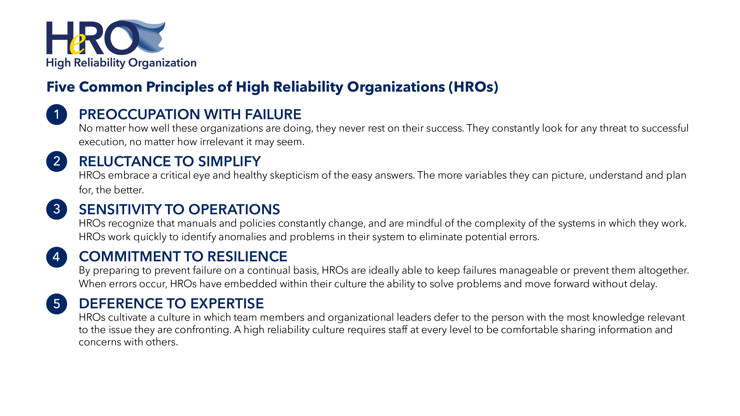

Slide 7
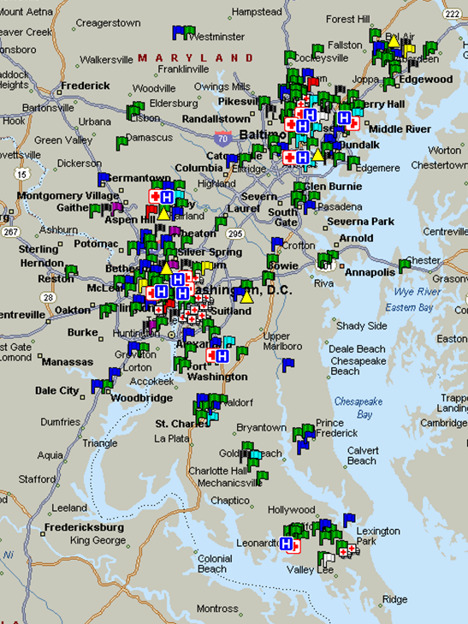
About MedStar Health
8th largest secular non-profit health system in US
10 Hospitals, ~300 Ambulatory Sites
85 Zip codes
31,000 associates
5,500 physicians, 8,400 nurses
175,000 inpatient & Obs/year
4.5M outpatient visits/year
$5.8B Revenue (non profit)
~ 100k Covered Lives/Insured
Georgetown Partnership
9th largest GME in US (1100)
Top 15% in NIH research dollars

Slide 8
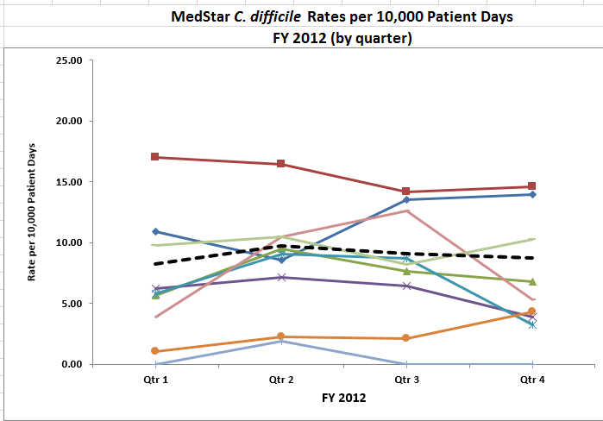
The starting point: FY12 rate 8.95

Slide 9
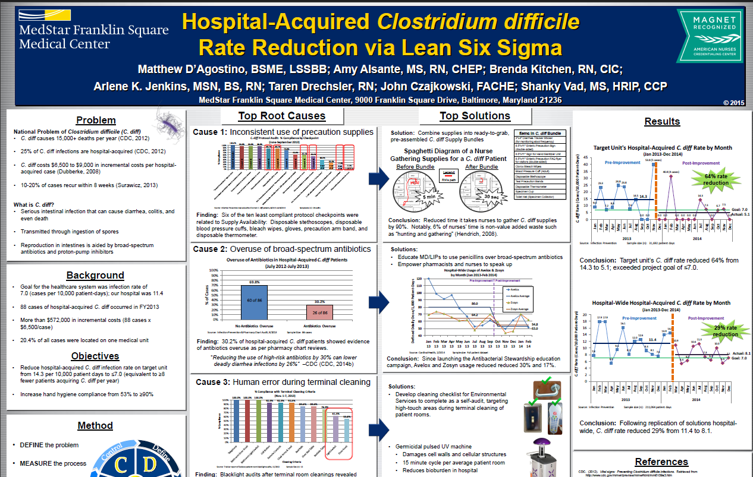
9
Notes:
Started as PI project at MFSMC: Their rate at the time was >11
Used standard PI tools and identified top root causes:
Inconsistent use of precaution supplies and policies
Antibiotic overuse
Terminal cleaning variation
Solutions developed and implemented which resulted in a 64% reduction in rates on the target unit, and a 29% overall organizational reduction

Slide 10
“Inside-out” solution development
Focus on Hand Hygiene compliance
  Supplies for staff and patients
Development of clinical bundles
  Enteric precautions design kit
  New Orderset development
  Development of organizational Mpage for monitoring
  Remove PPIs from standard admission Orderset
  Physician education letters re. PPI usage
  Pharmacy auditing of PPI usage
  Improved antibiotic and diagnostic stewardship
EVS Initiatives
  Developed cleaning checklist
  Changed to bleach for cleaning of Enteric Isolation
  Improved room marking & cleaning
  Implemented Surfacide UV technology
  Standardized EVS training (including simulation)
Notes:
In the management of CAP, limited Moxifloxacin prescribing to people with beta-lactam allergies only
Created Mpage for C. diff monitoring of tests
Implemented Crothall OMIT program throughout MSH hospitals
Crothall established this for segregating EVS workers. Here is how they explain it:
It is a specialized duty list. One (or more) High Profile Cleaner will perform the daily occupied room cleaning for all Enteric isolated Patients across the campus. This was designed to mitigate any horizontal contamination from an enteric room to non enteric room from an EVS worker. Depending on census of Enteric rooms, will depend on number of Omit cleaners. For the most part it is one associate, however at WHC at times it is more.
All sites provided hand hygiene product to patients
Developed nurse driven protocol C. diff lab test (some hospitals)
Used bleach to clean hospital every Wednesday & total bleach cleaning used on selected units
Used bleach for all terminal cleanings; bleach for daily and terminal cleaning in the ICU
Developed new order set including automatic enteric isolation and notification of infection control if C. diff test ordered

Slide 11
The importance of diagnostic stewardship
Notes:
Build an automatic order-review into MedConnect
Other hospitals are already doing this
Review of ‘overrides’ for tests ordered > day 3
Approval by IP/ID for inappropriate testing
Labor-intensive
May improve with eventual provider education and feed back

Slide 12
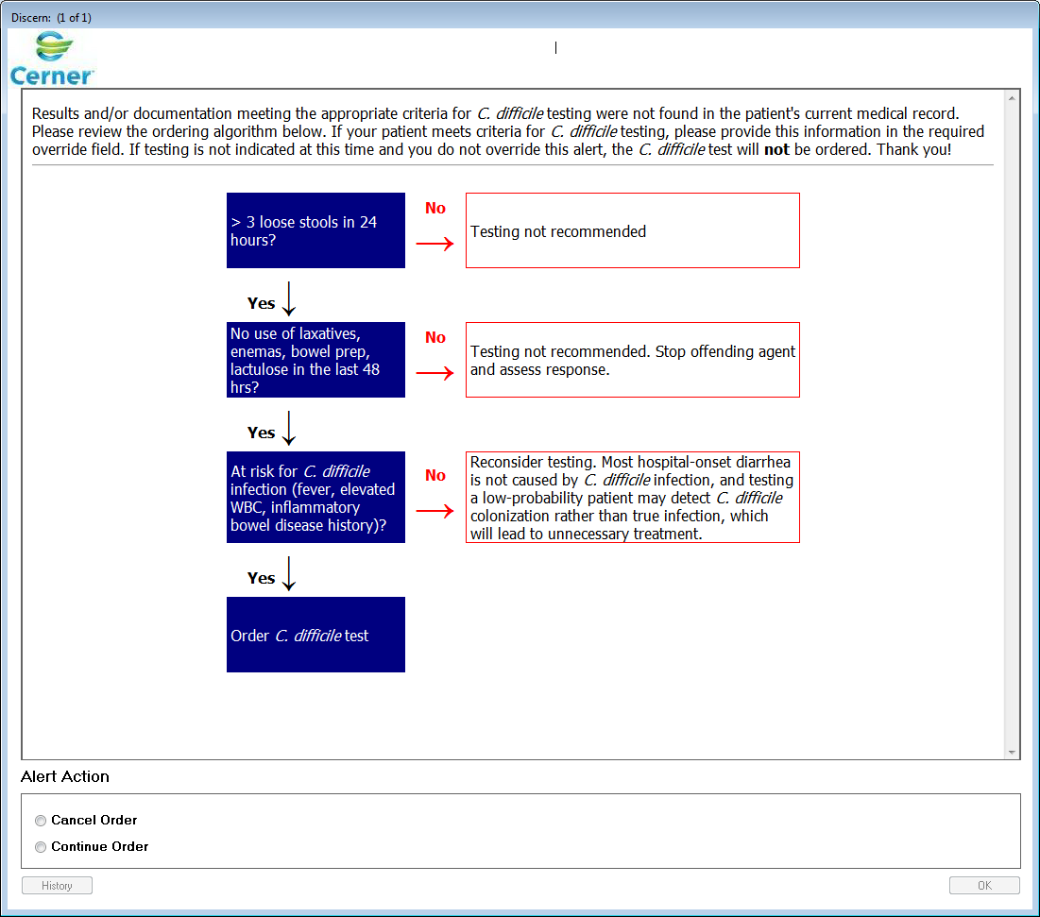
12

Slide 13
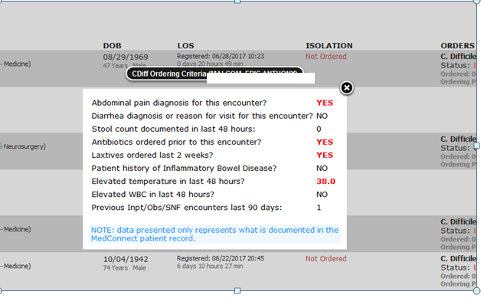
EHR Decision Support Tools

Slide 14
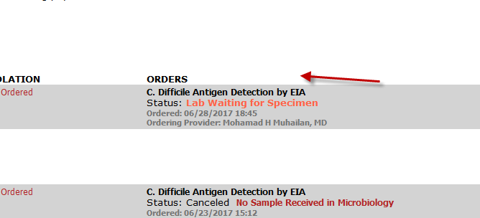

Slide 15
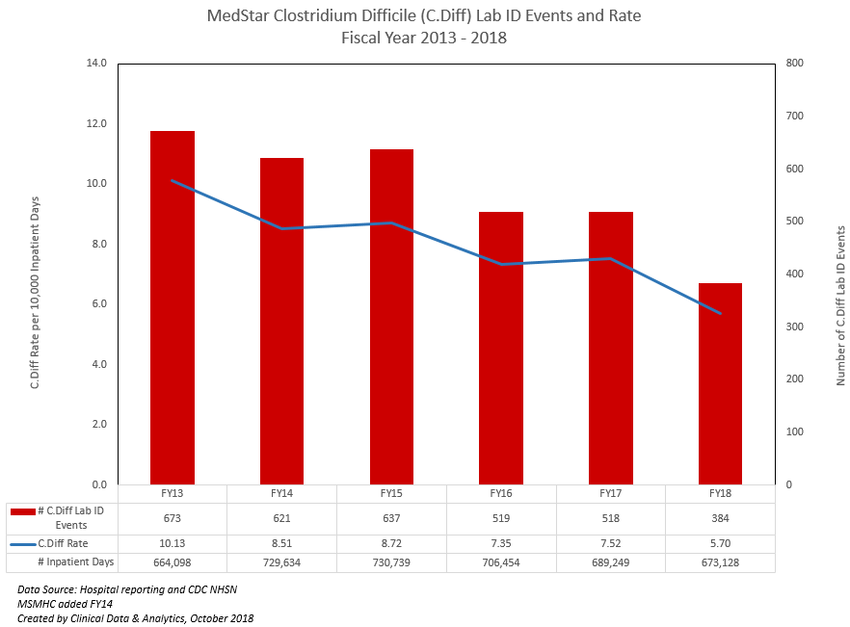

Slide 16
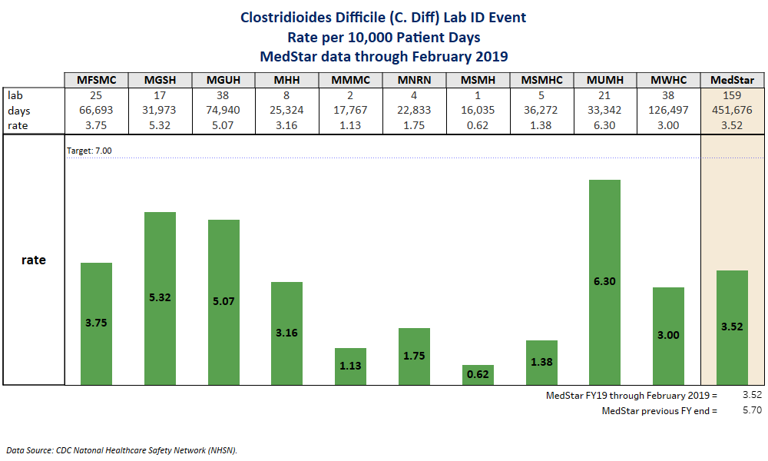
IC12_CDIFF_Rate.png
CDIFF rate per hospital

Slide 17
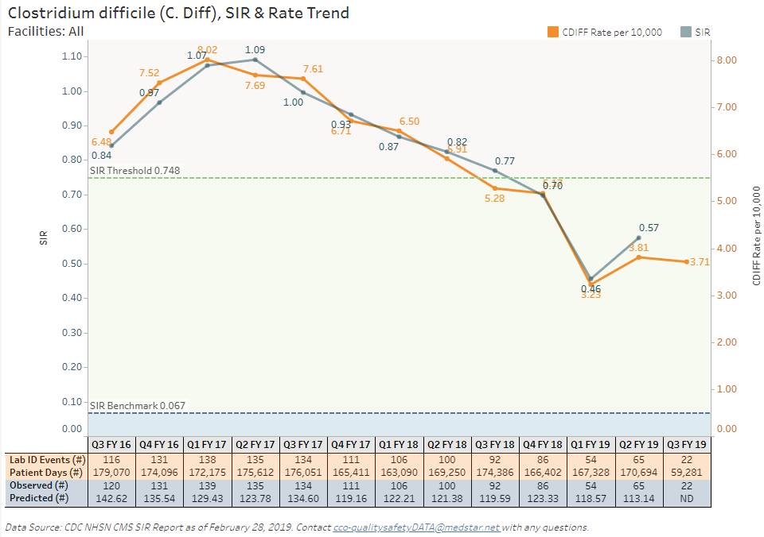

Slide 18
MedStar Health Quality and Safety Program
2010: MedStar 2020
  Vision: Highest Quality & Safety
2011: MedStar Institute for Innovation (MI2)
  National Center for Human Factors in Healthcare
2012: Commitment & Senior Leadership
  1st Vice President for Quality & Safety
2015: Scaling: AHRQ “CANDOR” (Event Review)
  Parallel engagement with IHI/NPSF RCA²
2018: Goal: Influencing National Change
  MedStar Institute for Quality & Safety (MIQS)

Slide 19
Driven by our Values:
“This is about doing the right thing” for the patient and family
“Let me make it clear. We will not become one of the highest quality and safety organizations in the US without investment. While we will not see an ROI in this quarter or this year’s annual financial report, in the long run there will be a ROI and it will pay off in many ways.”
--Mike Curran, Executive VP and CFO, MedStar Health (at Senior Managers Meeting, 2012)

Slide 20
The Importance of Organizational Leadership and Safety Culture
Becoming a High Reliability Organization
  Commitment to universal training
  Safety Stories
  Good Catch Program
  Safety Huddles
  Daily Safety Stories
  Safety Coach Program
  Just Culture-based Performance Management
  Event reporting and review process
  HeRO awards, programs, luncheons

Slide 21
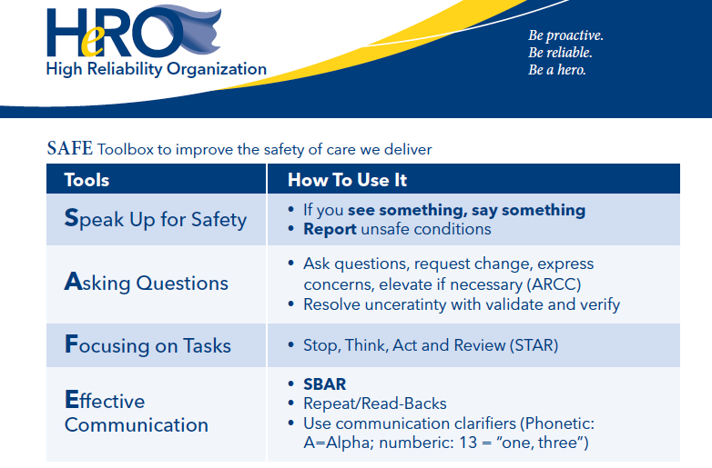

Slide 22
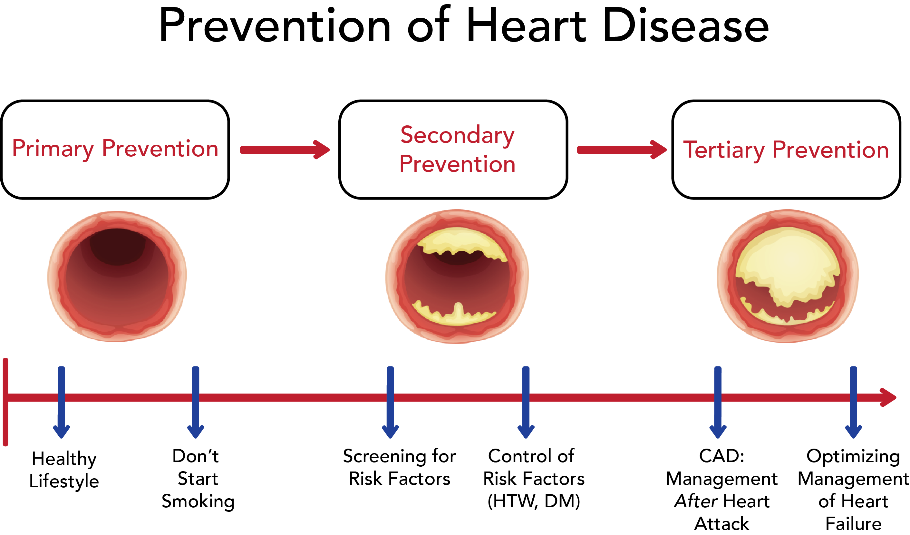
Notes:
kate

Slide 23
MedStar Health’s Integrated Patient Safety Transformational Model (PST)TM
Proactive
Proactive
Reactive
Primary Prevention
Secondary Prevention
Safety Event
Tertiary Prevention
Realities of Actual Context
Design System for High Quality and Safety, Low Risk
Identify and Mitigate Existing Hazards
Recover and Learn from Events

Slide 24
MedStar Health’s 3 Approaches to Safety & Risk
1º (Proactive)
2º (Proactive)
3º (Reactive)
Design System for High Quality and Safety, Low Risk
Identify (Data Science)
& Mitigate (Safety Science)
Existing Hazards
Recover and Learn from Events
Optimize System for Safety
People
  Selection
  Training (initial/ongoing)
  Expectations/Guidelines
System/Tech/Process
  Safety Culture
  Clinical Excellence
  Patient Satisfaction
  Process Design
  Standard Work
  Device Selection
  Built Design
Potential Data Sources: ID Risks
Associate Observations
Event & Error Reports (PSE/RL)
Risk Mgt /Claims Data
Workers Comp
Safety Survey Comments
HCAPS Scores & Comments
Safety Huddle Notes
Peer Review, OPPE trends
Patient Complaints
SSE/Near Miss Event Reviews
Good Catch Program
EMR Analytics & Helpdesk Calls
Insurance/Risk Organizations
Marketing Feedback
NRC Picker comments
Public sites (Google/ZocDoc)
Follow-Up Calls
Physician Satisfaction Surveys
Response to Events
“CANDOR” Program
SUO–Early Notifications
Event Reviews–Early Learning
Care for Patient & Family
  Immediate Optimal Care
  Transparent Communication
  Hold all Bills (while learning)
  Disclosure & apology if fitting
Care for the Caregiver
Impact Change/Learning
  System-focused (mitigation)
  People-focused (peer review)
Learning
Learning
Learning
Learning
Notes:
out

Slide 25
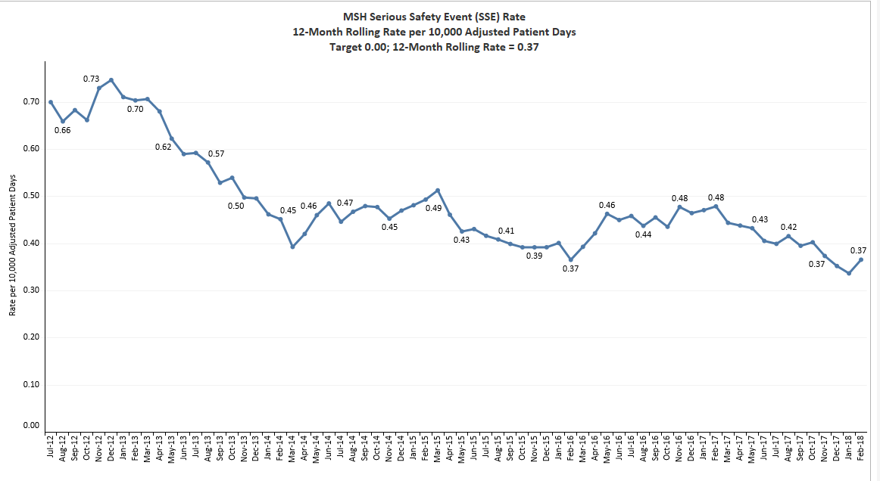
6-Year Safety Trend: SSE Rates

Slide 27
Conclusion: Leadership commitment matters!
Hospital and system leadership, system and local governance, medical and nursing staff partnership and buy-in
HRO Journey and system focus on safety
Linking clinical quality and financial results
  Good medicine=good finance
Continuous improvement culture

Slide 28


